Slide 1
Spring MVC Overview
August, 2016

Slide 2
Agenda
Model View Controller (MVC)
Spring MVC
Dependency Injection Principle
Dependency Injection Example
Architecture and Spring Boot

Slide 3
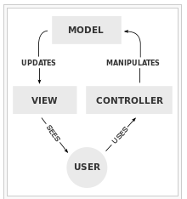
MVC
1
MVC is a software architectural pattern for implementing user interfaces on computers. It divides a given software application into three interconnected parts, so as to separate internal representations of information from the ways that information is presented to or accepted from the user.
2
3
4
5
M
odel
represents data
V
iew
represents UI part
C
ontroller
manages the application flow, makes a call to some sort of service producing Model, and then passes on the model to the view

Slide 4
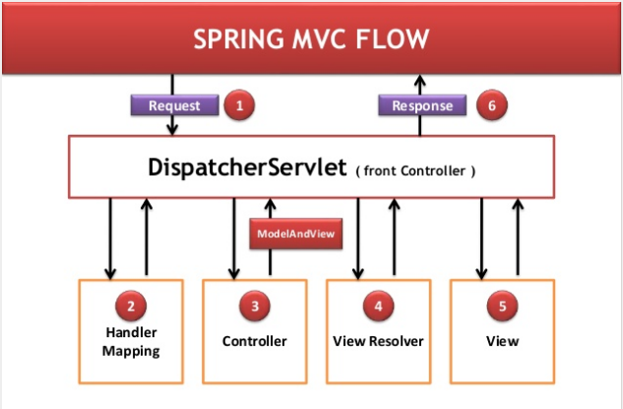
Spring MVC
1
Spring MVC is a web application development framework, and supports for inversion of control (or the dependency injection).
2
3
4
5

Slide 5
Spring MVC Flow
1
4) The DispatcherServlet tries to resolve the view by consulting the View Resolver Object.
5) The selected view is rendered.
6) Rendered View back to client
1) Request will be received by DispatcherServlet.
2) DispatcherServlet will take the help of HandlerMapping and get to know the Controller class associated.
3) Controller will process the request and returns ModelandView object back to the DispatcherServlet.
2
3
4
5

Slide 6
Dependency Injection Principle
1
Outsource the task of handling all dependencies of an object to an expert (it could be some third party program), in order to use this third party program you will need to use interfaces in your project.
Interface will be responsible of binding
NEVER create an object inside another class using a new operator.
2
3
4
5

Slide 7
Dependency Injection Example
1
1
2
2
class Restaurant {
Tea tea = new Tea();
public void prepareHotDrink() {
tea.prepareTea();
}
}
3
3
class Tea {
public void prepareTea() {
//code here….
}
}
4
4
5
5

Slide 8
Dependency Injection Example
1
1
class Restaurant {
@Autowired
IHotDrink hotDrink;
Restaurant(IHotDrink hotDrink) {
hotDrink = this.hotDrink;
}
public void prepareHotDrink() {
hotDrink.prepareTea();
}
}
interface IHotDrink {
public void prepareTea();
}
2
2
3
3
4
4
5
5
class Tea implements IHotDrink {
public void prepareTea() {
//code here...
}
}

Slide 9
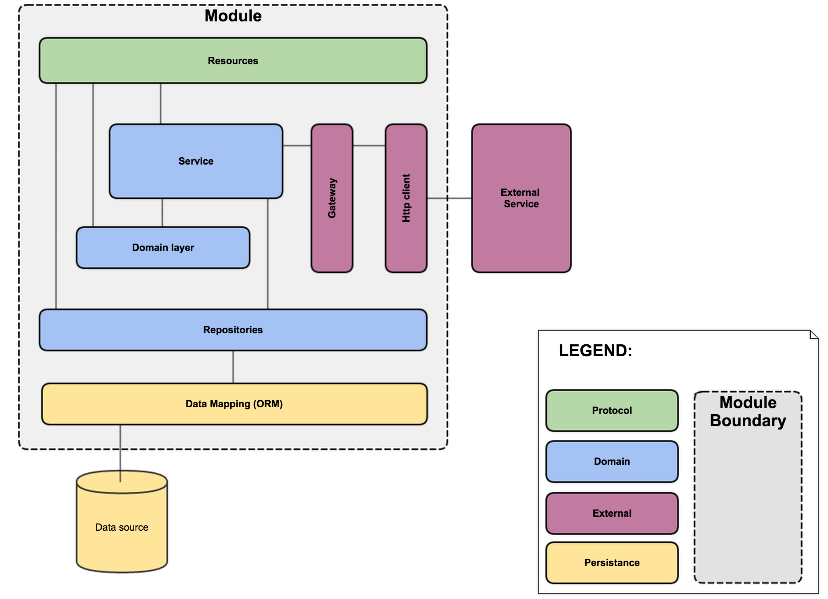
Architecture and Spring Boot
1
Fast
2
3
4
5

Slide 10
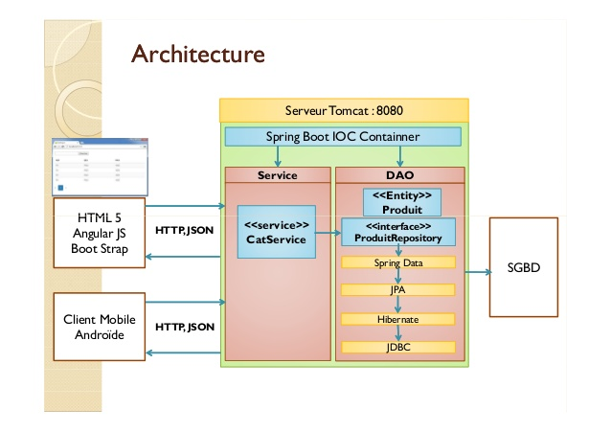
Architecture and Spring Boot
1
2
3
4
5

Slide 11
Resources
https://www.youtube.com/watch?v=kIqNz2T9rx8
https://www.youtube.com/watch?v=7YcW25PHnAA
https://spring.io/guides/gs/rest-service/
https://spring.io/guides/gs/actuator-service/
https://www.youtube.com/watch?v=2u88jLdDFwQ
https://www.youtube.com/watch?v=4A2SH0QS1vo

Slide 12
SOLID
S https://www.youtube.com/watch?v=nyxaChZ1row
O https://www.youtube.com/watch?v=EpvfSQEJq68
L https://www.youtube.com/watch?v=LkqWvVXNDKw
I https://www.youtube.com/watch?v=dmKvJyihsAQ
D https://www.youtube.com/watch?v=d4uBBvnreXw

Slide 13
Questions…?

